Slide 1

Major Project
The memory game
Notes:
- Hi and welcome to my presentation about my game project!
- I have made a memory game.
We will start with show you how the game work before we deep into the code

Slide 2
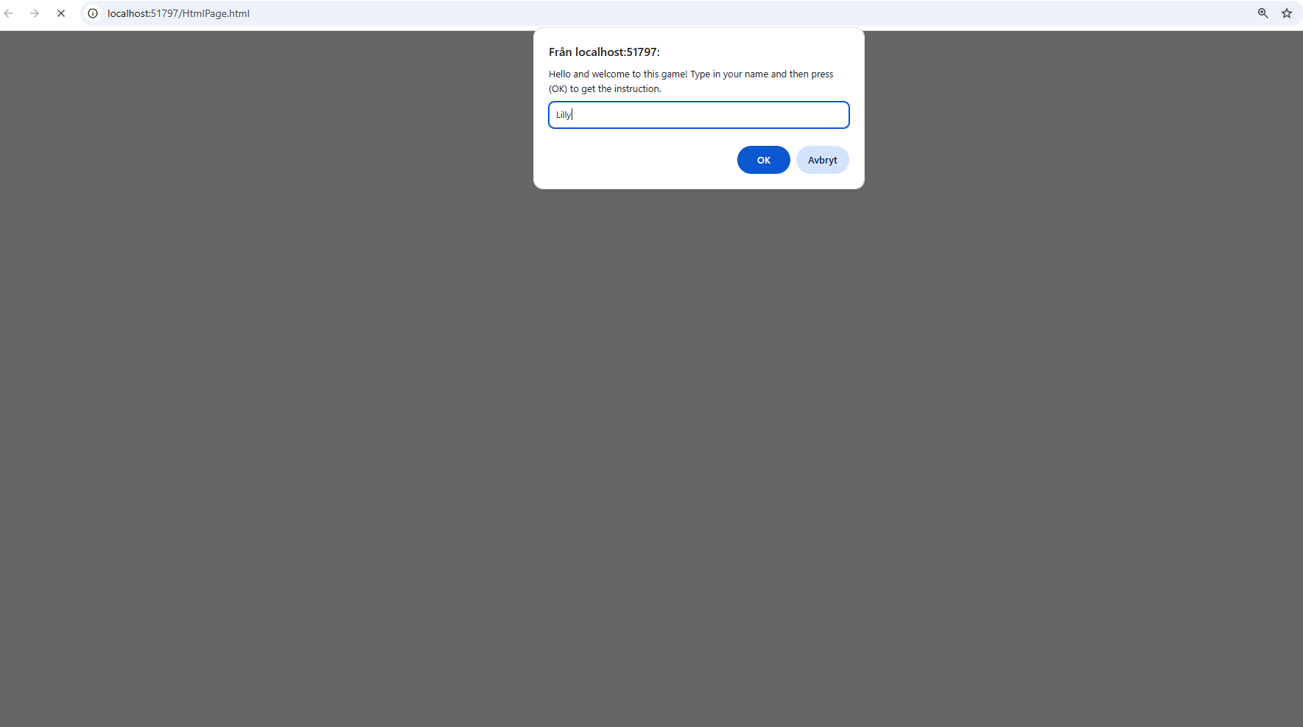
Notes:
We start with write in our name and press ok or enter

Slide 3
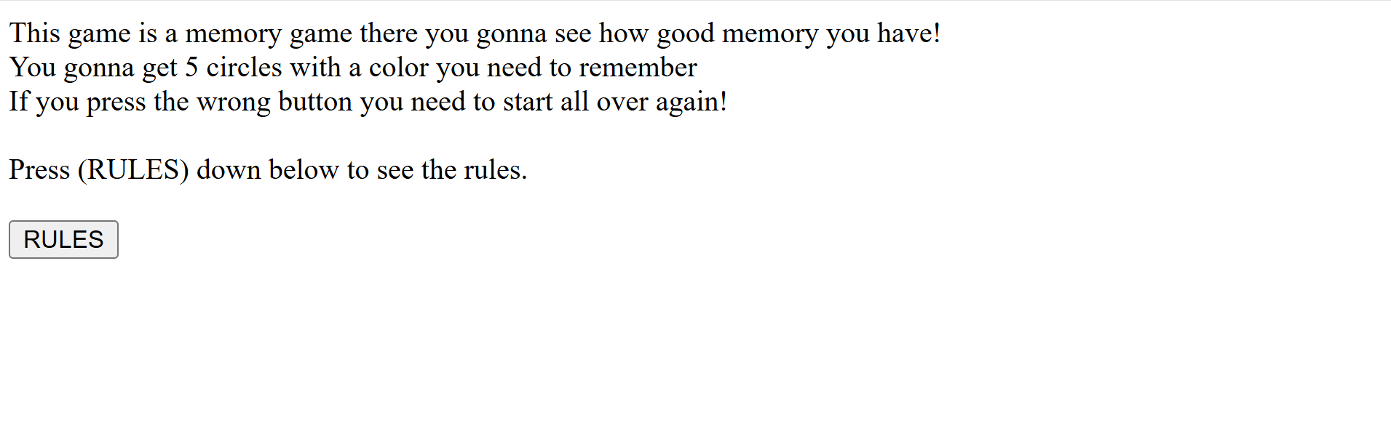
Notes:
Then you gonna get a short sumary of what you will do in this game before we press at the rules button

Slide 4
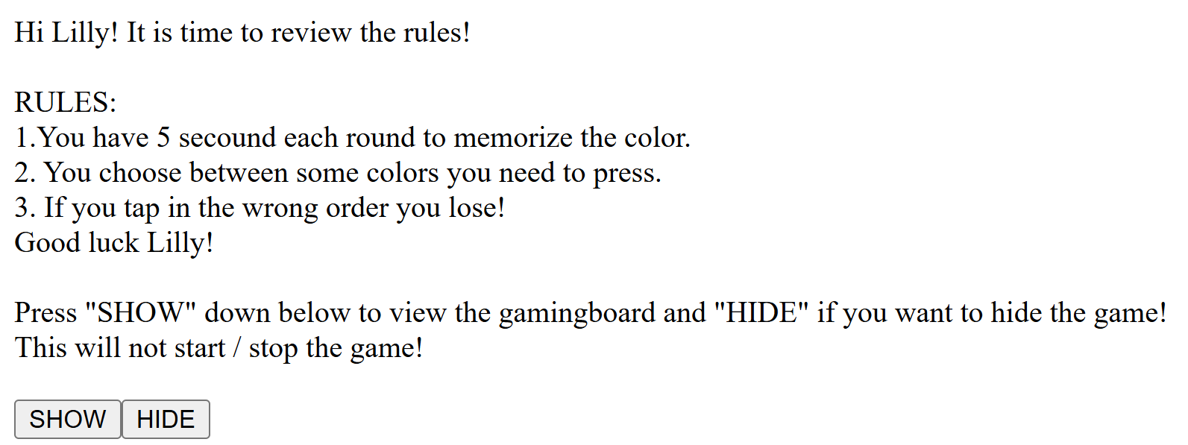
Notes:
At the rules page you gonna get more detailed information of what you will do. You will also see two buttons there you will see the start button when you press show

Slide 5
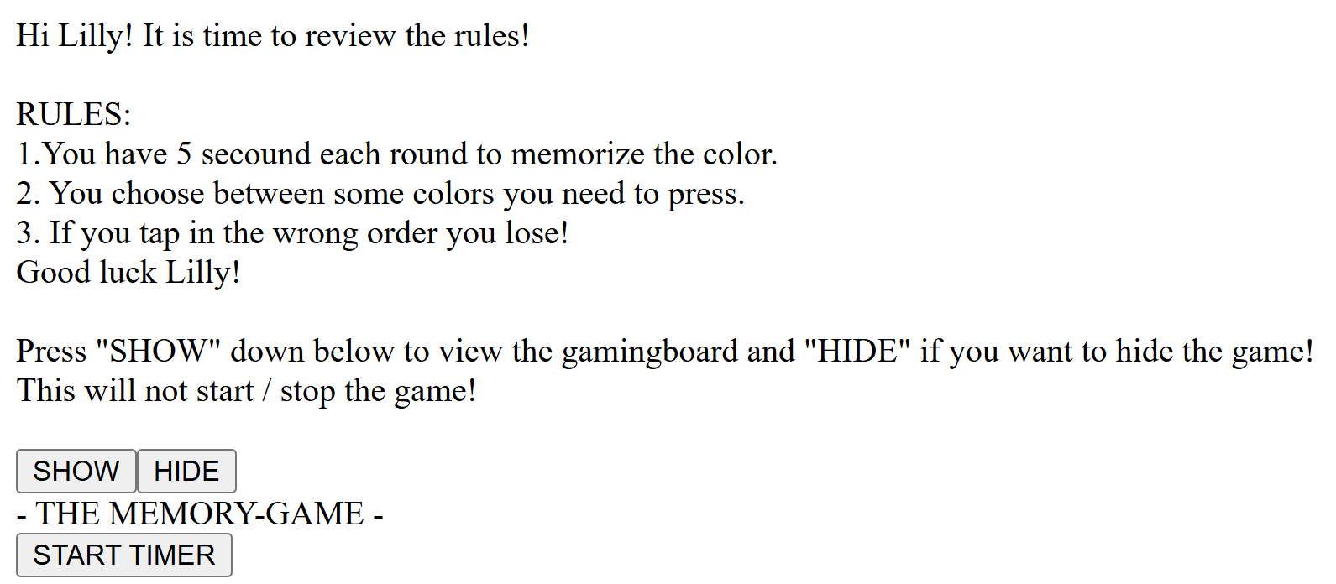
Notes:
When you have press on the show button the gamingboard will pop up but to run the game you need to press ”START TIMER”

Slide 6
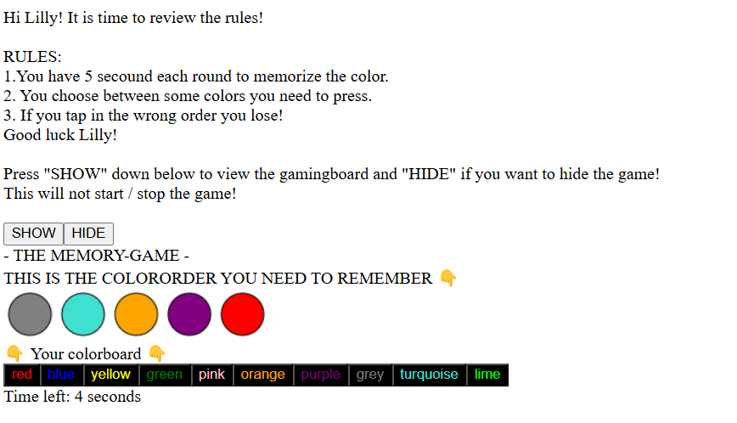
Notes:
You have now 5 secounds to remember the colororder, you can also see the buttons. But you can´t press on them right now

Slide 7
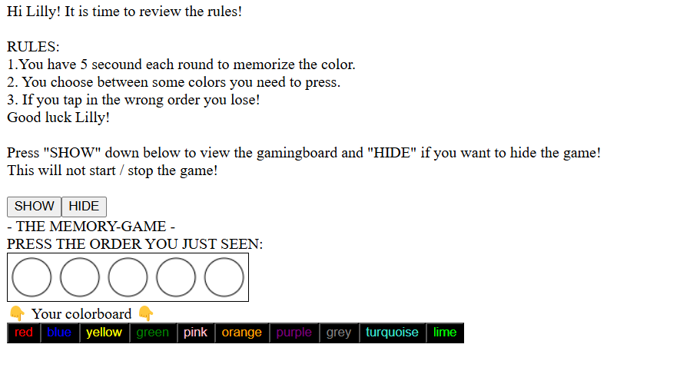
Notes:
It is time to guess the order

Slide 8
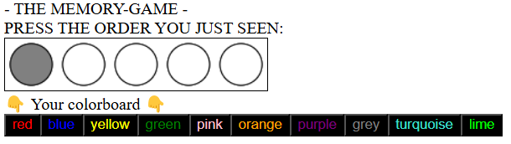
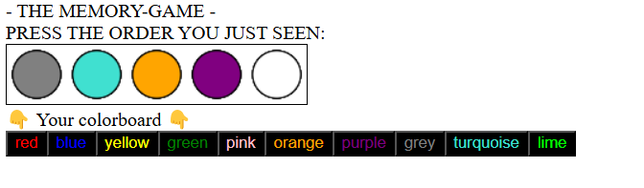
Colorbuttons
Make the colorbutton works
Get the right message
Notes:
The colorbutton is now working and it is time to press so all the circles is fills

Slide 9

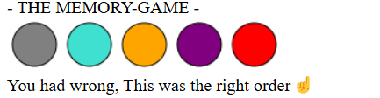
Coreccting
Right
Wrong
Notes:
When you have press that all the circles is filld you get a correcting answar. it get a message who say that they ether have right or wrong. If it’s the wrong order the user get a feedback that the order is wrong and show up the right order

Slide 10
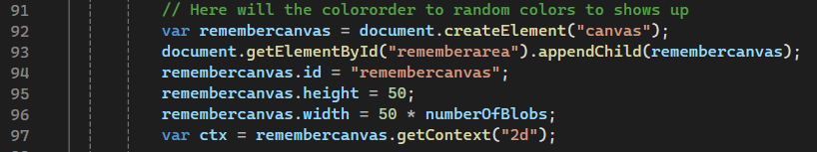
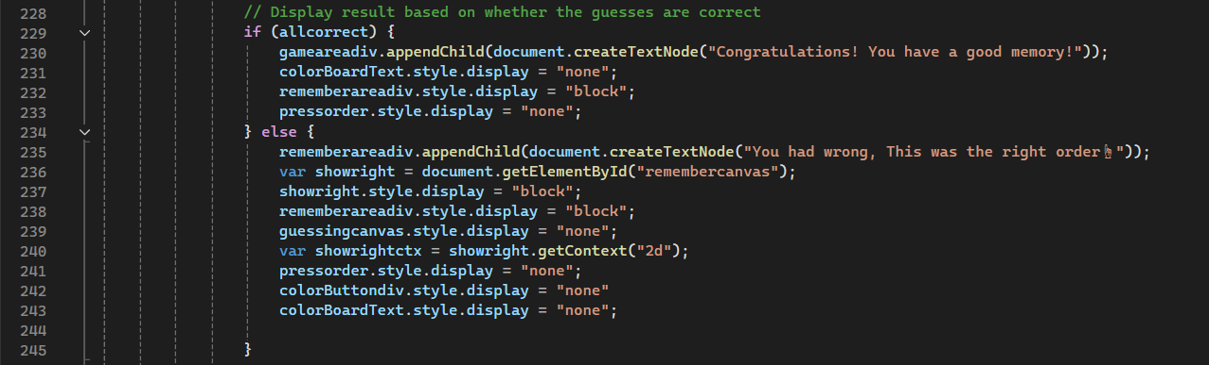
Included
Canvas
If/else
Notes:
We will now check the code
- To get a Canva you need to create the canvas with a element and connect it with a appenchild. To get it there we will we need to get a element and a id
- With the id we have the oppertunity to create the size of the canva
Ctx need to get the canvas context also 2D
If/else
We use if or else to create statement that the program will do eather one thing or another deppending of what the user choose

Slide 11
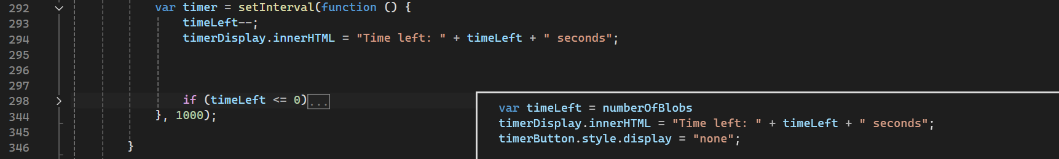
Included
Timer
Forloop
Notes:
Timer do that you can get a intervalve on what you want the program to do during a special time, For example in this code is when things will show and hide. A function and then how long the timer will wait.
For loop make that you can repetate many things again without make same code x amout of time
- to make that we need a variable … the variable tell us what it will do the ++ can be – deppending if it should be when it have do up to something or down to something

Slide 12
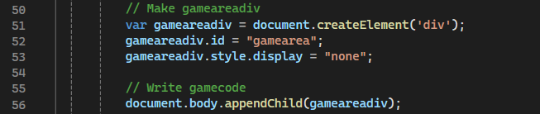
Included
Prompt
Array
Div, id, appendchild, createelement
Notes:
- Prompt give the user the oppertunity to get a message back
An array make that you can set values in a list and use the list for example randomize the color to memorize
div make a place in the document, id make that we can find the div in the code, create elemente to create diffrent elements like divs, buttons and canvas
Appendchild make that we place something in the document or add a button to a div for example

Slide 13
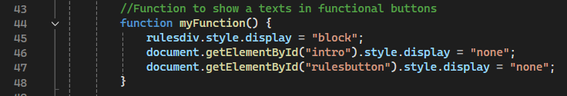
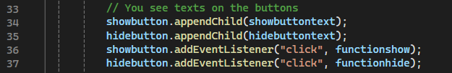
Included
Functions/ style.display
Eventlistners (buttons)
Notes:
Function is code that we will use over and over again.
We can use Style.display to show and hide items in the program
- addEventListners create functional buttons, when we click it call the function to do something.

Slide 14
Experience/reflections
Easy parts
Prompt
Button to go to next page
Hide and show
Harder parts
Canva
Colorbutton
Correct
Innerhtlm
Notes:
The easy part was the start in the program until I needed to create Canvas. All the buttons until the Canvas part.
The harder parts was to create the Canvas if the reason that I needed to make many steo. I needed to use an array to save the colors, a Canvas. To create the canva I needed to use a Id, Createelement, variable to use to a hight and a width
To connect the colorbuttonten addcolor function and a forloop and a if statement false and true function and a break.
You use innerhtlm to get a text in the script part. Document.write clear the code after the commando and therefore we use interhtlm in a div to run the code. With that methode we can easier place the code there we will have it

Slide 15
The budget
The idea from start
Add more functions
Several rounds
Several levles
Time
Finished
Developed
Notes:
As the idea from start, I could add more button who works and have diffrent functions like
Add a new canva dots to remember
Add more then one levle
Time
I managed to create a finished game that can be presented.
I stick to the budget on the most relevanted parts. That I could developed more is the function to continue the game with more rounds even if its not to add more dots and levels. Like add a function who gave the user to start over again and try again without reloding the page.

Slide 16
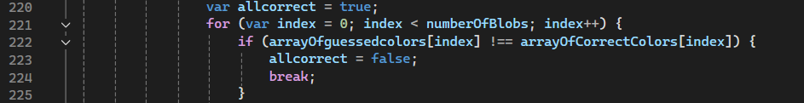
Problem
Many problems
Canvas
Correcting
Div,id and createelement
Notes:
I've had many problem with the code. Some of them was bigger then the others. The biggest problem was that almast all tutorial about the diffrent functions was only made in the htlm part and not in the script part.
I found a tutorial about who to make a canva and we have also learn that at the lesson but also that time i only see this timr only in the htlm part.
When I first made the correcting button I have a problem that the program not correct like i wanted. I got two message if the first color was right but not the otherone. To fix this I

Slide 17
Thanks for you have listened

